Slide 1
Sindh – the land of endless opportunities
Presented by
Chairman
Sindh Board of Investment

Slide 2
World Bank Ranking – Ease of Doing Business 2011
As per WB’s Ease of Doing Business Report 2012, Pakistan is third ranking among the Asian Countries and 2nd best in the region in terms of trading across borders, getting credit and in protecting investors
Notes:
Change the chart

Slide 3
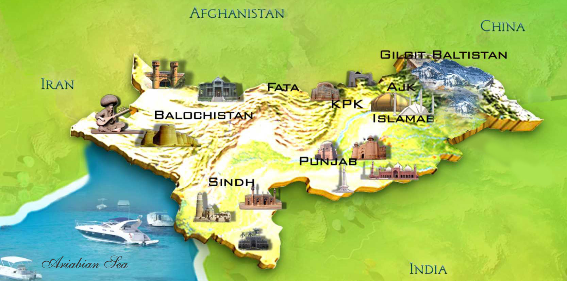
At the Center of Asian Growth
Pakistan is Asia’s trade, energy and transport corridor
CENTRAL ASIA
MIDDLE EAST

Slide 4
Sindh Board of Investment
Focal Point for All Investment in the Province
Provide Framework for implementation of Investment Policy of Federal Government and to support provincial endeavors
Investment protection by looking after legitimate interests of businesses
Provide platform for Public Private Partnerships
Provide One – Window system at the Provincial level for facilitation of local and foreign investors seeking land, approvals, concessions, facilities and support from the Provincial Departments and authorities

Slide 5
Sindh’s Competitive Edge
Financial Capital of Pakistan – Karachi
Karachi Stock Exchange ; Headquarters of Banks, Financial Institutions & Business houses
42% of LSM located here
Two Seaports and an International Airport
The Regional Power House of the Future
Thar Coal – 100,000 MW for 300 Years
Wind Corridor – 50,000 MW potential
Oil – 56% of country’s production
Gas – 70% of country’s production

Slide 6
Sindh’s Competitive Edge
Large Agricultural base
With 5.45 m hectares of cultivable land
World’s Best & Centuries old Irrigation System
Sindh Produces:
73% of Banana
34% of Mangoes
53% of Dates
88% Red Chilies
40% Onion
Trained, educated workforce
350 KMs long Coast Line- Tremendous opportunities for tourism and fisheries sector

Slide 7
Incentives for Investment
Reduced foreign equity requirement (US $ 0.3M)
Repatriation of 100% capital, profits, franchise fees
Zero duty on raw material imported for production of export material
Zero rated import duty on Agri machinery (not manufactured in Pak) for registered corporate Agri projects
A full incentive package for corporate farming

Slide 8
Public Private Partnership
Sindh PPP Framework:
Sindh PPP Act; Country’s first PPP law
Provides legal cover to the Institutional Framework (PPP Policy Board, PPP Unit, PPP Projects and departmental PPP nodes)
Regulates the contractual relationship between public and private sectors
Covers processes regarding project approval and spending from
Project Development Fund
Viability Gap Fund

Slide 9
Public Private Partnership
Government Support
Licenses and clearances , utility connections for power, gas and water, land or rights of way
Political risks, delay of agreed user fee adjustments, (MRG), early termination, Force majeure and Demand risk
Direct financial assistance
Viability Gap Fund
International Financial Structures & Frame-work
PPP Sindh offers international parameters of concession like Force majeure cover, Political risk cover

Slide 10
Why Invest in Energy Sector
Huge Gap of Supply-Demand
Special Incentive Package for
Investment in Renewable
Sector.
Wind & solar irradiation at
the chosen site in Sindh
Pakistan, is even better
than the European average
by comparison
Total power generation capacity
- forecast
in MW
144 590
+640%
92 760
54 270
17 400
27 420
Increasing Energy Demand

Slide 12
Thar Coal Mining & Power
Reserves: 175 billion tons
Proximity: 270 kms from Karachi Port
Energy Potential: 100,000 MW for 300 years
Quality
Stripping ratio: 6:1
Heating value: 5000 btu/lb
Incentive Package
Declared as Special Economic Zone
Tax Exemption: 30 years
IRR: 20% US dollar based
Zero rated custom duties on import of plant & machinery

Slide 13
Thar Coal Mining & Power
Ways of Collaboration by Turkish Institutions & Companies
Investment in Existing Open-pit Coal Mining/ UCG Projects
Three Open-pit Mining & Power Project are at take-off stage
One UCG Pilot Project is at execution stage
Investment on Developing Thar Coal-based Power Plant
Either at Mine Mouth or at Jamshoro/ Badin
Conversion of Existing RFO-based Power Plants
Acquiring New/ Independent Blocks at Thar Coalfield
Investment in Building & Operating Railway Link to Thar Coalfield
Collaboration by Universities/ Training Institutes to upgrade Polytechnic Institute at Mithi, Thar District.

Slide 14
Wind Energy

Slide 15
Wind Energy Projects
Land rent for Direct Impact Area: US 17 Cents per sq yd per annum
Upfront tariff of 14.67 cents/ kwh for (18 months CoD)
Long term Power Purchase Agreements (20 years) backed by sovereign guarantees
Coverage of Wind Speed Risk (for Cost Based Projects)
Fiscal incentive through zero tax regime
Guaranteed 17 – 18% IRR
32 Wind Power Projects with installed capacity of 2000 MWs are at different stages of completion- FINA Energy and ZORLU

Slide 17
Bus Rapid Transit
Bus Rapid Transit (BRT) is a high quality metro like transit service
Utilizes exclusive right-of-way bus lanes
Project Involves:
Identified 06 Corridors (03 Priority Corridors)
Facilitates 12,000 passengers on a person – per – hour – per – direction basis
700,000 Passengers Boarding per Route
Fare Estimation 20 cents per passenger/per trip
Estimated Annual Revenue for 3 Corridors: USD 90 million with 26.6% EIRR (JICA Report)
Notes:
Put rates of land

Slide 18
Bus Rapid Transit; Project Costs
Three Priority Corridors of Karachi City
BRT Line | Length (km) | Stations | Est. Project Cost (Million USD)
BRT 1 | 25.0 | 23 | 146.0
BRT 2 | 15.5 | 10 | 90.5
BRT 3 | 4.0 | 4 | 23.0
Total | 44.5 | 37 | 258.5
Notes:
Put rates of land

Slide 20
Education City Project
A high class Education and Health Institutions enclave planned in outskirts of Karachi to bring knowledge and skills together for growth and prosperity
9000 acres earmarked and Master Plan under finalization
Core elements:
Educational and Health institutions
Research & Development within one boundary
Residential facility
Over 15 top national institutions have already been allotted land including Aga Khan Foundation; M/S Ziauddin; M/S SZABIST; Judge Business School Cambridge University
Estimated Project Cost: USD 300 mn

Slide 22
Arfa Karim Technopolis (AKTP)
Features:
Spread over 200 acres in Education City Karachi
Fully serviced plots for custom built offices
Multi- fiber - optic and satellite internet connections
Double circuit power supply; automated surveillance system
Food court, convention halls, entertainment & sports
Target Institutions:
Training; Hardware Manufacturing; IT service providers
Media agencies; Call centers; Graphic design simulations
Project Structure: Government seeking Design Build Finance Operate Intervention under PPP mode
Estimated Project Cost: USD 1.7 million

Slide 24
Sukkur Dry Port
Pakistan has 10 dry ports operated through various agencies
Sukkur being 3rd largest city of Sindh Identified as commercially viable given the scale of Agro, Oil & Gas Businesses
20,000 container volume with an economic value of Rs. 4 billion (USD 45 million) per annum
Potential for growth linked to ease of transactions
Identified Land: 50 acres
Mode: Public Private Partnership
Total Project cost: ~ USD 10 million

Slide 25
KHAJOOR MANDI & DATES PROCESSING PLANT

Slide 26
Khajoor Mandi Khairpur
Khairpur is single largest dates producing district of Pakistan
300,000 ton/annum production
City lacks wholesale market with efficient infrastructure
Estimated Project Cost USD 41.5 million
Planned under DBFOO structure under PPP mode
Salient Features
Date Section 250 Shops with Dry & Cold Storage Auction Sheds Auction Shed for growers | Banana & Vegetable Section 120 Shops with Cold Storage Auction Sheds Auction Shed for growers

Slide 27
Dates Processing Plant
Presently dates exported without much value addition (Primarily in Pitted form)
Huge potential for value addition:
Available for big scale exports to entire Muslim World
Development of Dates Processing Plants
Washing, drying, packaging, pulping & Date Syrup
Estimated Dates Processing Project Cost (25,000 ton/year): USD 12.0 million

Slide 28
Mango, Guava & Tomato Processing, Pulping & Paste Plant

Slide 29
Agri Processing Plants
Sindh’s horticulture share of national production
73% banana, 34% mangoes,
53% dates, 40% onion,
88% red chillies
Sindh produces
70,000 tons of Guava and
30,000 tons of Tomato per annum
Huge Quantity of Perishable Agri Products are wasted every year
Guava and Mango pulp and paste already being exported to Middle East Market
Estimated Project cost of Processing Plant : USD 3.0 million

Slide 30
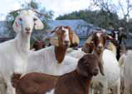

Slide 31
Halal Meat Park
Project titled “ Bhambhore Dairy and Meat Park” planned
In district Thatta, spread over 1300 acres
Availability of all required internal infrastructure
Chilling units, feed mills, slaughter houses; livestock and fodder market within
This Halal Meat Park can generate 1200 Metric Tons of meat per year
On Dairy side: 320-400 Metric Tons of milk daily
Estimated cost: USD 30 Million

Slide 32
Shrimp Aquaculture
Sindh coastline 350 km; 70% of country’s marine resources
0.3 million hectares of brackish water area; a net- work of creeks, low lying areas and backwaters
Ideal conditions for Shrimp Aquaculture – natural hatcheries in terms of water & air temperature, salinity, and tides
20,000 acres of dedicated land earmarked
Suitable for Banana, Tiger, Jaira and White shrimp
Estimated cost USD 27 million for 500 Acres of Shrimp Aqua Farm

Slide 34
Keenjhar Lake Resort
Keenjhar Lake - a Ramsar site
Plan to create an Eco Tourist Resort under PPP mode
750 acres land located at a distance of 113 km from Karachi
Resort Hotel; Chalets; Private Residential Farmhouses
Conventions; Golf Course; and
Recreation component :
Amusement Parks; Water Sports and Boating facilities;
Shopping mall, with local crafts, food court and Cineplex;
Economic and Commercial Viability
A Real Estate commercially viable project
Entails big economic boost for the region
Estimated Project Cost: US $117million
Notes:
Put rates of land

Slide 35
Thank you

