Slide 1

Overseas Private Investment Corporation:
The U.S. Government’s
Development Finance Institution
Renewable Energy and Energy Efficiency
Izmir, Istanbul, Gaziantep, Ankara
24-27 Octorber 2012

Slide 2
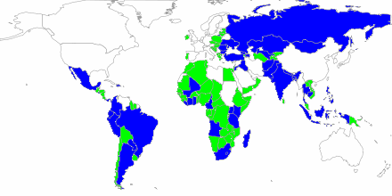
OPIC Snapshot
Green = Countries with Active Projects (107)
Gray = OPIC eligible countries (150+)
Established in 1971
Provided $188 billion of financing and insurance to support highly developmental projects
Operates on a self-sustaining basis at no cost to the American taxpayer.

Slide 3





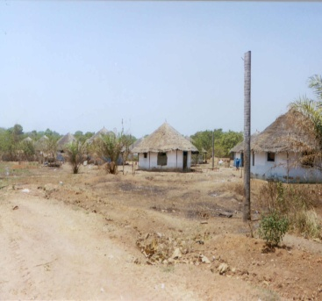
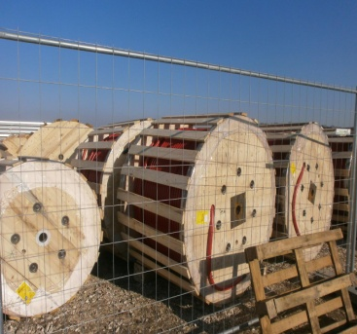
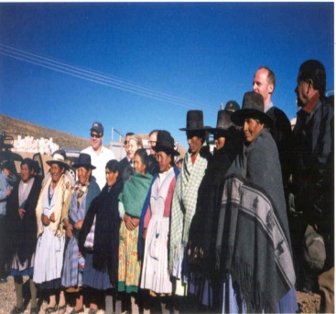
OPIC By the Numbers:
Fiscal Year 2011
Total Portfolio, FYE | $14.5 _{Billion}
Committed | $3.2 _{Billion}
Catalyzed | $4.4 _{Billion}
Commitments in Low-Income Countries | 61%
Projects with U.S. Small Businesses | 78%
Profit Per Employee | $1.3 _{Million}
Host Country Jobs Created | 19,046
U.S. Jobs Supported | 1,373
Notes:
The numbers are still needed for the pie chart…TBD

Slide 4
OPIC Primary Products
Project Finance
Loans from $1 million to $250 million
Political Risk Insurance
Investment Funds Leverage
Fixed interest rate
Currency in USD
Leverage up to 75%
Expropriation
Political Violence
Currency Inconvertibility
Funds can be sector and/or regionally focused
Provides debt to Private Equity Funds
Tenors up to 20 years

Slide 5
Project Finance (debt)
Eligibility
25% of Project Company owned by U.S. party OR significant long-term involvement of U.S. party (through licensing, royalties or leasing)
Less than 50% foreign gov’t ownership in Project
Framework
  Limited recourse project finance
  Loan sizes from $1-250M
  Loan Tenors up to 20 years
  Fixed rate U.S. dollar financing based on U.S. Treasuries plus risk spread
  Long history of support to small & medium-sized enterprises

Slide 6
OPIC-Akbank Finance Facility
Eligibility
Turkish companies seeking financing for clean energy or energy efficiency projects

Slide 7
Insurance
Eligibility
  U.S. equity investors or U.S. debt providers
Framework
  Insurance protects against Political Violence (including terrorism), Expropriation & Currency Inconvertibility
  Fixed premium
  Cancellable only by Insured
  Tenor up to 20 years
  Up to $250M per project

Slide 8
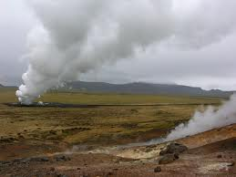




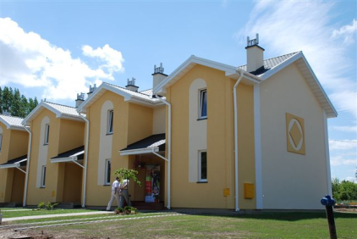
$1.1 Billion in commitments for
Renewable Energy Finance and Insurance Projects
$498 million in approvals for financing to private equity funds
Important priority representing 1/3 of all commitments in 2011
Notes:
Other noteworthy facts to mention:
-Supported projects in every key sector – wind, solar, hydro, geo, biomass, e.e. & clean tech
-Developed new tailored products (FiT, leasing)
-Avoided 931,000 tons carbon emissions

Slide 9
FY10 + 11 Renewables Commitments

Slide 10
Quadruple Bottom Line
Fiscal
Economic
Environmental
Social/
Developmental
Commitments
Disbursements
Net Income
Local jobs created
Communities w/
access to energy
MW Renewable
Energy added
Co2 avoided
  U.S jobs supported
  U.S. businesses
  reach new markets
Notes:
Fiscal = return money to US government, make smart business decisions
Social/developmental = don’t just do any projects, developmental mission
Environmental = OIP evaluates, approves and monitors
Economic = US effects, wont do a project that will take away even 1 US job

Slide 11
Product Innovations for Renewables:
Finance
Retrofit
Sub-Debt
Direct financing for Renewable Energy & Efficiency improvements with repayments tailored to expected cost savings.
    Benefits =Working with SMEs; Ability to process small loan sizes
Energy Efficiency Facilities
Financing U.S. financial intermediaries to offer a financing package for Energy Efficiency improvements.
    Benefits = Reaches a spectrum of customers; Minimal investment required of manufacturers
Leasing
Lease financing through U.S. equipment vendors to reduce upfront capital costs to end users.
    Benefits = Extensive leasing experience; Ability to diversify risk
Carbon Credit Warehousing
Financing for renewable energy & clean tech solutions to end users, which will ultimately generate carbon credits as a revenue source.
    Benefits = Grassroots approach to implementation; Bridges local development needs with international investment markets

Slide 12
Product Innovations for Renewables:
Insurance
Feed-In Tariff
Cover
Political insurance protection against the risks of change to regulatory mandated feed-in tariffs.
    Benefits = Provides greater assurances of cash flow; Mitigates a primary concern of most RE investors
Carbon Credit Insurance
Insurance protection against the risks of foreign gov’t actions or inactions that can impair an investor’s ability to realize carbon credits.
    Benefits = Ensures the commercial viability for projects dependent on carbon credits
Breach of Contract Cover
Insurance coverage to protect investors from defaults by host gov’t off takers in power purchase agreements.
    Benefits = OPIC maintains bilateral treaties with foreign gov’ts to motivate commercial behavior

Slide 13
Contact Information
Peter Ballinger
Director, Business Development
Peter.Ballinger@opic.gov
+1 (202) 336-8400
Our Website
opic.gov

