Slide 1
The Near-Zero Zone: Inspiring Industrial Energy Efficiency in Turkey
Istanbul
September 25, 2012

Slide 2
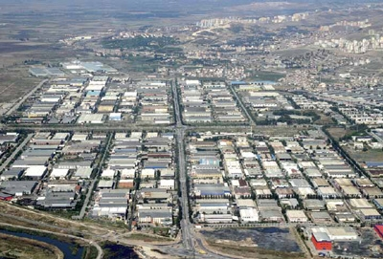
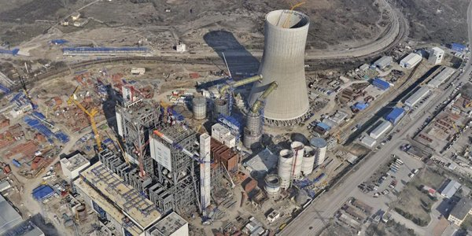
Turkey:
Industrial Sector
Industry is Turkey’s largest Energy Consumer (39% of total energy consumption)
Industrial electricity consumption increased annually at 4.9% from 1999-2009
Energy efficiency opportunities in industry are commercially attractive

Slide 3
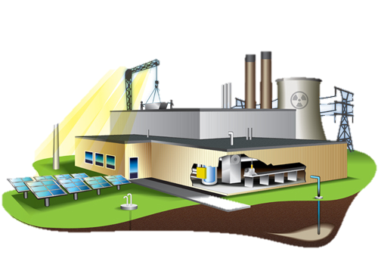
Why energy efficiency in turkey?
Turkey’s rapidly increasing energy needs (Primary energy consumption expected to grow to 5.7% annually to 2020)
Expansive industrial sector (21.8% of GDP)
Significant potential to improve energy efficiency in industrial sector
Savings potential conservatively estimated at 24%
Over 50% of industrial EE projects expected to have payback period of less than 2 years
Economy would benefit from reduced demand for energy imports

Slide 4
Seizing the moment
Government of Turkey is Promoting Energy Efficiency to Bolster Energy Security by Reducing Reliance on Imports and Improve Economic Growth
The Government of Turkey has drafted new legislation incentivizing industrial energy efficiency by offering grants, establishing guidelines for regular energy audits, setting criteria for companies, and more.
Significant resources are flowing into Turkey to support efficiency projects.
EBRD/TURSEFF - $260m Turkey Sustainable Energy Financial Facility with five Turkish partner banks
World Bank (CTF) - $250m for renewable energy and EE
EX-IM & OPIC programs focused on Turkey including OPIC funds established with Ak Bank and Garanti Bank

Slide 5
CHRONOLOGY of EVENTS
President Obama visits Turkey
Companies Begin Technical Assessments
January 8-10 Istanbul Technical Training
U.S. TDA Exploratory Mission
NZZ Companies Begin to Make Upgrades
04/2009
06/2010
01/2011
02/2011
06/2011
08/2012
09/2012
01/2013
Next
Oak Ridge Conducts Baseline Energy Studies of NZZ Companies
NZZ Participants Share Results in Turkey
Replication
DOE Energy Efficiency Conference in Istanbul
Technical Assessments Completed
IAOSB Selected as Pilot Project Zone

Slide 6
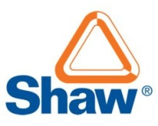
PARTNERS
Notes:
The NZZ Project included participants from the Government of Turkey, USG agencies including DOE, Dept. of State, Dept. of Commerce, OPIC, and TDA, and U.S. and Turkish companies, business associations, and lenders

Slide 7
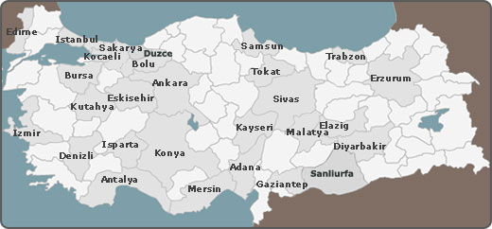
LOCATION OF THE NEAR-ZERO ZONE PROJECT

Slide 8
NZZ COMPANY PARTICIPATION
Ataer
Bak Ambalaj
Baylan Ölçü
Cms
Denizciler Dökümcülük
Dirinler Döküm
Dost Cam
Ege Tekstil
Egeplast-Ege Plastik
Eltaş Trafo
Esen Plastik
Felda Iffco
İaosb Water Treatment
Korozo
Kroma Baskı
Maktek Alpel
Norm Civata
Özgün Boya
Polibak
Schneıder Elektrik

Slide 9
ENERGY EFFICICENCY ASSESSMENTS
Facility Overview
- Facility Energy Usage
- Key Energy Systems
2. Industrial Processes Overview
3. Utilities Overview
4. Energy Cost Reduction Measures
- Objective
- Issues and Observations
- Recommendations
- Costs and Benefits
- Corollary Impacts and
- Potential Heat/Energy Surplus
- Implementation Cost
- Annual Energy Savings
- Annual Electricity Savings (kWh)
- Annual Natural Gas savings (therms)
- Annual Water Savings (kl)
- Demand Reduction (kW)
- CO₂ Emissions Reduction (metric tons)
- Internal Rate of Return (IRR)
- Net Present Value (NPV)
- Simple Payback Period
- Impact on Operations
Complexity of Implementation
Analysis and Strategy
5. Materials Pricing Guides

Slide 10
ENERGY AUDITS
Companies received reports with recommendations on how they could reduce energy and save money.
Reports included cost of savings opportunities, expected payback period, etc.
Recommendations were classified as short, medium, or long term depending on the number of months to get a return on the investment.

Slide 11
Energy efficiency recommendations
20 IAOSB Companies

Slide 12
NZZ Project RESULTS and Impacts on 20 IAOSB Companies
Estimated total of $6.1M/11M Turkish Lira in annual energy cost savings
Estimated total of 64 million kWh in energy savings – on average 24% of energy consumed
Assessments of 20 companies revealed the average payback period was as low as 12 to 18 months
Average IRR was 56%
Assessments identified cost-effective opportunities for companies to invest in cogeneration - $4M/7M Turkish Lira savings with shared water resources
Approx $250M/450M TL in power generation equipment sales and >$16M/27M TL in energy efficiency product and services

Slide 13
NZZ Project Impacts on Turkey
271 Zones (Presently, 157 in operation) 52,000 Companies
If 10% of total companies implement similar cost saving measures, could save the equivalent of 17 billion kWh of electricity and reduce energy costs by $1.6 billion per year.
Turkey could build approx. 6 fewer coal-fired power plants and could import 6% less natural gas.
Reduction in CO₂ emissions would have an impact similar to taking 1.7 million cars off the road.

Slide 14
NZZ Project accomplishments
Win-Win for Turkish and US Private Sectors
Turkish businesses increase profitability while reducing energy consumption
New business opportunities for Turkish and U.S. companies
OPIC’s new $250M energy efficiency lending facility
Project Supported the Government of Turkey’s Objectives to Promote Industrial Efficiency Across Turkey
Increased pubic awareness about commercial and environmental benefits associated with industrial energy efficiency projects.
Concentrating resources on a single zone allowed the project to achieve greater impact and helped identify unexpected opportunities and create a replicable model for industry.

Slide 15
NZZ Project BENEFITS
The project has influenced public-private partnerships and cooperation that can spread industrial energy efficiency efforts across Turkey
Project is inspiring the development of an energy service company market
Creating more opportunities for more energy efficient manufacturing equipment and other products
Project has shown that companies outside the industrial zones can also make energy efficient choices

Slide 16
NZZ Project NEXT STEPS
U.S. Department of Energy has an interest in working with Turkey’s Renewable Energy Directorate (REGD) to provide a technical assistance for companies interested in energy efficiency projects
A training event will take place in Istanbul on January 8-9, 2013.
All 271 industrial zones and companies in each zone will be invited.
Energy efficiency experts, assessment companies and financiers of energy efficiency projects will attend.
If you are interested in attending as a participant or to exhibit, please contact Shane Harper at shane.harper@hq.doe.gov
Replication of project by other companies and industrial-zones across Turkey

Slide 17
Industrial Energy Efficiency is a win-win: Kazan, Kazan.
THANK YOU

