Slide 1
Best practices from the RCOP Projects in the Republic of Croatia
Ankara, 25 March 2014
Vlatka Kos, Quality Assurance Department, CFCA, Croatia

Slide 2
Introduction & overview
General hints & experiences related to management
Human resources management and workload resolving
Importance of awareness raising, education and visibility
Project preparation and QA & proper implementation mechanisms/tools
Procurement issues- problems encountered and novelties applied
Examples of successful RCOP projects

Slide 3
Awareness raising and education
Informing public and various target groups about possibilities to either participate in tender procedures as tenderers (service, supply, works) or receive grants
Stress should be given to potential grant applicants
Being informed on grant schemes
Organize education – what is a grant contract, how to prepare project proposals, budgets, implementation issues, sustainability of projects…
Visibility – education and communication purpose, not only coverage of EU visual identity
Brochures, leaflets, workshops on all levels especially regional/local, media coverage, web sites

Slide 4
Human resources and workload
Plan and envisage the number of staff needed to cover all the tasks efficiently; an honest and precise workload analysis for each institution/department
Bear in mind possible fluctuation (elements such as possible discrepancies in salaries between the involved insitutions?)
Staff retention policy, strategies

Slide 5
Quality assurance
Special attention paid to careful preparation of tender dossiers for service, supply and works – terms of references and market analysis & technical specifications- foundation for the contract and the final product delivered to the beneficiary (four-eyes principle)
Evaluation
Monitoring of implementation – project reports, on the spot verifications, verification of invoices

Slide 6
IT and Management Information System/MIS
Ensuring a solid IT system
Connection of all involved stakeholders
MIS – a single complex database which should be planned & developed timely (needs analysis and study of processes) and with clear input structure and delegation of tasks; tracking all procedures and complete system
Consisting of many modules which enable various reporting: accounting, financial indicators of OP implementation, verification, certification plan, requests for payments, on the spot plan

Slide 7
Procurement issues- applying new tendencies
Putting emphasis on best value for money (instead of lowest price) – creating scope for quality solutions, economically most advantageous offer (price principle is faster and more transparent, but does not provide for necessary quality) HOW TO EVALUATE QUALITY (key experts, organisation & methodology, esthetics, functionality, availability, maintenance costs,...)
More scope for innovative solutions, defining TS in terms of performance or functional requirements
Providing sufficient time for submission of tenders
Ensuring wise payment schedules – providing sufficient funds to contractors to implement the contract, but leave enough funds for the final acceptance of outputs – linkage of payment to outputs delivered
Green public procurement- purchase of energy-efficient computers and buildings, recyclable materials, environment-friendly transport, systems complying with state of the art environment solutions (e.g. Energy Star)
Alleviating administrative burden (monitoring – project reports containing shorter systematic info)

Slide 8
Transition to national procurement act
FACING CHALLENGES DURING TRANSITION FROM THE USE OF PRAG TO NATIONAL PROCUREMENT LEGISLATION
Transition period – steps should ideally be prescribed in some kind of a document
Contracts contracted before accession under PRAG, which need modifications – how to prepare addenda –PRAG or national procurement act?
Getting acquainted with national procurement act – new documents-procurement notices, tender dossiers, new terminology, new deadlines (52 vs 40), evaluation steps
Different approach – what is supply vs service (licenses vs software development), available budget is always published, amended contracts are often treated as new contracts, rule of origin...
Tenderers' complaints procedure to the State commission for supervision of complaints! – great obstacle – time consuming procedure, expensive

Slide 9
Grant schemes in Croatia
The Regional Competitiveness Operational Programme has contributed to the wider objective of preparing Institutions for European Union membership.
It has also helped to build up institutional capacities and gain practical experience in management of investments, such as those co-financed by the European Regional Development Fund.
the goal of achieving the strategic priority of developing social and economic cohesion in Croatia.
Operating structure: Ministry of Economy, Ministry of Entrepreneurship and Crafts, Ministry of Science, Education and Sports, Ministry of Regional Development and EU funds, implemented by CFCA

Slide 10
Business Related Infrastructure
Value 19.8 mil
Responsible Authority – MRDEUF
Implemented by CFCA
Involving 10 undeveloped counties
Goals – development and strengthening of the SMEs and creation of new jobs
Primary activities – investing into infrastructure, development in the existing business zones, development of new and existing business incubators and other entities for offering support to small and medium business, investing into the development of the public tourism infrastructure

Slide 11
BRI
End recipients – units of local self-government, local tourist board offices, communal companies and various agencies
3rd call published in 2013

Slide 12
Completion of the Faust Vrančić Memorial Centre
Value 1.306.477,95 EUR
Beneficiary - Town of Vodice, Šibenik-Knin County
Goals: overall development of cultural tourism on the Island of Prvić and increase in the number of the employed
Results – expanded cultural tourism offer, provision of education and training related to the development of cultural tourism to the local management, tourist workers, prolonged tourist season, new jobs
Key activities: exhibit design and opening of the museum
End recipients: tourists and SMEs

Slide 13
Memorial centre Faust Vrančić

Slide 14
Developing new tourist products eco-ethno centre Adica – Vukovar golden embroidery
Value - EUR 781,777,50
City of Vukovar
Goals: contribute to the sustainable socio-economic development of the county by expanding tourist offer, development of public infrastructure
Results: new tourism related infrastructure, capacities of the local authorities, integration of local citizens and enterprises, visibility of new tourism products, inclusion of women in entrepreneurship
Activities: construction of infrastructure, organisation of education and ethno fair

Slide 15
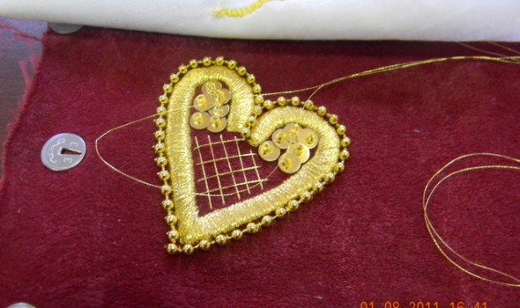

Slide 16
Museums on wine roads
VALUE 1,250,482.85 EUR
BENEFICIARY Osijek-Baranja County
GOALS
Creating new jobs and foster economic growth in parts of the region that are particularly lagging behind in development, by encouraging the development of sustainable tourism based on cultural heritage and wine making tradition
EXPECTED RESULTS
Upgraded quality and diversity of the tourism offer in Osijek-Baranja County by building new and reconstructing existing tourist attractions
Staff trained in various segments of the tourism offer
General public informed of new tourism offer
Increased competitiveness of local wine producers and creation of cross-border and transnational producer networks
PRIMARY ACTIVITIES
Reconstruction of existing and construction of new tourist attractions -wine road and wine museum
Education and training of tourism services providers
Promotion of tourist destination
END RECIPIENTS
Local communities in Osijek-Baranja County, SMEs, agricultural cooperatives, hotel owners, tourists

Slide 18
Tourism valorisation of the cultural and historical heritage and public infrastructure of Nehaj Park

Slide 19
Nehaj fortress
VALUE 989,682.85 EUR
BENEFICIARY City of Senj
GOALS
To develop tourism and small and medium-sized enterprises in Lika-Senj County through the economic valorisation of the cultural and historical potential of the region
EXPECTED RESULTS
Improved tourism infrastructure
Enabling environment for SME development
System of cultural and historical resources planning and management, developed
Improved capacity and competitiveness of tourism sector
A recognisable cultural tourism destination promoted through the project
PRIMARY ACTIVITIES
Construction of infrastructure
Development of Nehaj Fort and Nehaj Park
Organisation of training and education
Marketing plan and promotional activities
END RECIPIENTS
City of Senj, City of Senj Development Agency, City of Senj Tourism Board, Municipal museum, Lika-Senj County, Local populationUnemployed persons, Students

Slide 20
Ivana's House of Fairytales Visitor Centre
VALUE 1,359,424.11 EUR
BENEFICIARY Tourism Board City of Ogulin
PLACE OF IMPLEMENTATION City of Ogulin, Karlovac County
GOALS
To develop infrastructure for cultural and history tourism that will stimulate the creation of new small and medium enterprises, and provide additional employment
To make the City of Ogulin a recognisable destination - ''Ogulin -City of Fairytales''
EXPECTED RESULTS
Ivana's House of Fairytales promoted as tourist attraction based on the wealth of cultural heritage
Upgraded knowledge and skills among local tourism professionals
PRIMARY ACTIVITIES
Construction works and development of cultural monument Ivana's House of Fairytales
Production of audio and video material, including possibility to select and hear 75 international fairytales in five languages
END RECIPIENTS
City of Ogulin, Ogulin's Tourism Bord,Conservation Department, Ministry of Culture, Karlovac County, Karlovac's Tourism Board

Slide 21
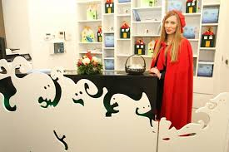

Slide 22
Lipizzaner horses promoting Slavonia
Value 515,397.83 EUR
BENEFICIARY City of Lipik
PLACE OF IMPLEMENTATION Lipik and Pakrac, Pozega-Slavonia County
GOALS
To assist in the revival of local tourism potential through the development and improvement of public tourism infrastructure in the cities of Lipik and Pakrac
To attract a greater number of local and foreign visitors
EXPECTED RESULTS
Five public and eight private properly marked and equipped thematic destinations
Development of a cross country cycling trail
Renovated façade of the Omanovac hiking lodge
Developed landscape around Lake Raminac
Education for family farms and members of associations
Trained tourism managers
Effective promotion of the trails
PRIMARY ACTIVITIES
Presentations to members of interested groups, Tender procedure for construction works, Procurement and installation of equipment
Construction works, Supervision of construction works, Education and training for all those active in the tourism industry
Development of tourism soft-infrastructure, Project management, Activities related to visibility
END RECIPIENTS
The local communities and the inhabitants of Pozega-Slavonia County

Slide 23
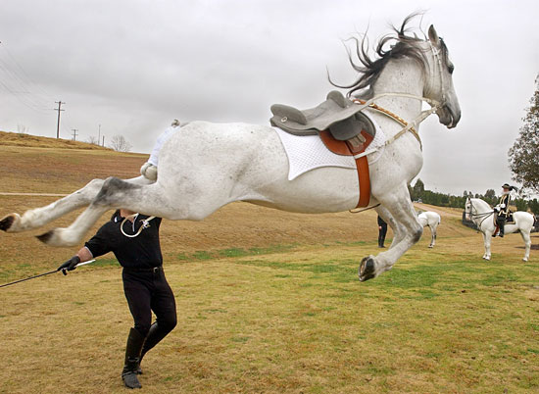
Lipizzaner horses

Slide 24
Agricultural success through the use of new technologies -Brod-Posavina County regional research & development biotechnology centre
VALUE 1,479,612.99 EUR
BENEFICIARY
Matija Antun Reljković Secondary School, Slavonski Brod
RESPONSIBLE AUTHORITY
Ministry of Regional Development and EU funds
IMPLEMENTED BY
Central Finance and Contracting Agency
PLACE OF IMPLEMENTATION
Slavonski Brod, Brod-Posavina County
GOALS
Using existing agricultural potential and resources, and applying research & development activities and new technologies in the agricultural sector, to foster economic growth in Brod-Posavina County
EXPECTED RESULTS
Centre for the production of seedlings, biotechnological research, development and advisory support to agricultural producers, family farms and SMEs
PRIMARY ACTIVITIES
Construction and equipping of a modern building
Education and advisory services for agricultural producers
END RECIPIENTS
Local communities in Brod-Posavina County, County Development Agency
Croatian Agricultural Advisory Service, Faculty of Agriculture in Zagreb, "Posavina vegetables" cluster in Slavonski Brod, "Slavonija voće" association of fruit producers, family farms,
secondary school students

Slide 25
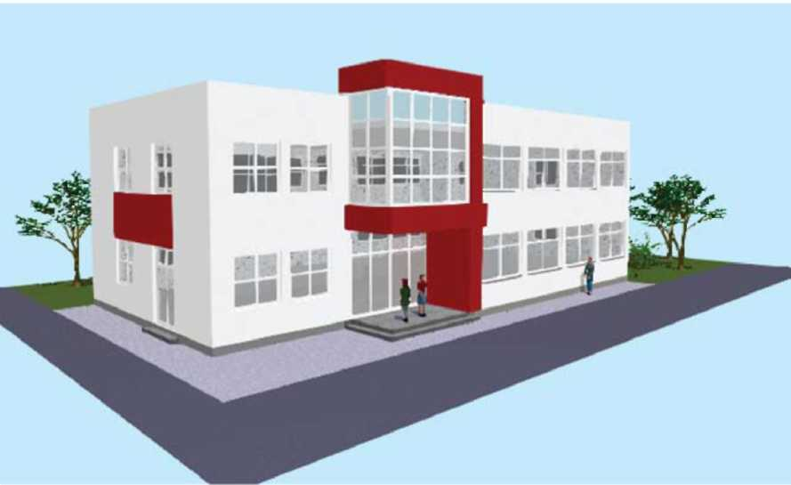

Slide 26
SCIENCE AND INNOVATION INVESTMENT FUND (SIIF)
VALUE
9.3 million EUR (SIIF I: 2.6 million EUR; SIIF II: 6.7 million EUR)
BENEFICIARY
Institutions of higher education and scientific institutions
RESPONSIBLE AUTHORITY
Ministry of Science, Education and Sports
IMPLEMENTED BY
Central Finance and Contracting Agency
PLACE OF IMPLEMENTATION
Republic of Croatia
GOALS
Better interconnectivity between the scientific community and economy with the goal of general economic growth
EXPECTED RESULTS
Results from scientific research that is applicable in industry
Strengthened capacities at Croatian scientific institutions for cooperating with industry
PRIMARY ACTIVITIES
Transfer of findings from scientific research from the science community to the economic sector
END RECIPIENTS
Public higher education institutions
Public research institutes

Slide 27
Marasca sour cherry as ingredients for functional foods
VALUE 496,800.00 EUR
BENEFICIARY The Faculty of Food Technology and Biotechnology - Centre Zadar
RESPONSIBLE AUTHORITY
Ministry of Science, Education and Sports
IMPLEMENTED BY Central Finance and Contracting Agency
PLACE OF IMPLEMENTATION Zadar
GOALS
Development and application of sophisticated technologies in the production of functional ingredients or finished food goods based on the Marasca sour cherry
EXPECTED RESULTS
Production of two new products on the basis of the Marasca sour cherry
( lyophilized and dehydrated Marasca sour cherries )
Establishing a laboratory for determining the biological activities of the afore mentioned products
PRIMARY ACTIVITIES
Equipping the laboratory
Pilot production plant producing lyophilized and dehydrated Marasca sour cherry products
Educating local producers and processors and the wider community as to the opportunities in producing and processing the Marasca sour cherry
END RECIPIENTS
Scientists
Local producers of Marasca sour cherries
Local population

Slide 28
Technology mapping at the University of Zagreb
VALUE240.964,00 EUR
BENEFICIARY University of Zagreb, Centre for Research, Development and Technology Transfer
RESPONSIBLE AUTHORITY Ministry of Science, Education and Sports
PLACE OF IMPLEMENTATION Zagreb
SPECIFIC OBJECTIVES Build technology transfer and commercialization capacities of the University of Zagreb in order to contribute to sustainable regional development and industry competitiveness of high value-added sectors of the economy and knowledge-based SMEs
EXPECTED RESULTS
Mapped technology potential and expertise at the University of Zagreb
Technology potential and expertise translated into industry through various technology transfer activities
Strengthened human resources for the above transfer
KEY ACTIVITIES
Strategic coordination of the development of technology transfer
Training of scientists
Preparation and implementation of technology mapping
Organization of networking activities
FINAL BENEFICIARIES Researchers, Entrepreneurs

Slide 29
University of Zagreb

Slide 30
Development of innovation system at the Ruder Boskovic Institute and the University of Rijeka
VALUE 413,027.67 EUR
BENEFICIARY Ruder Boskovic Institute
RESPONSIBLE AUTHORITY Ministry of Science, Education and Sports
IMPLEMENTED BY Central Finance and Contracting Agency
PLACE OF IMPLEMENTATION Zagreb, Rijeka
GOALS Contribute to increasing the competitiveness of the Croatian economy through the introduction of a more efficient system for the transfer of knowledge from the research and development sector to the business sector
EXPECTED RESULTS
A fully designed innovation system at the Ruder Boskovic Institute and the Rijeka University
Establishment of a joint database of knowledge
Opening the aforementioned database to entrepreneurs
PRIMARY ACTIVITIES
Mapping of research and innovation capacities
Forming a joint knowledge database
Education of scientists in the field of intellectual property and enterprise
Presentation of the research potential of the business community
END RECIPIENTS
Scientists
Entrepreneurs

Slide 31
Project 1) Capacity Building for Business Support - CABBS Project 2) Promotion and Provision of Advisory Services to SMEs" - SMEPASS
VALUE
Project 1) 1,344,900 EUR Project 2) 2,788,240 EUR
BENEFICIARY
Ministry of Entrepreneurship and Crafts; network of the Croatian business support institutions, SMEs, consultants
RESPONSIBLE AUTHORITY
Ministry of Entrepreneurship and Crafts
IMPLEMENTED BY
Central Finance and Contracting Agency
PLACE OF IMPLEMENTATION
Republic of Croatia
GOALS
Advance the quality and accessibility of consulting services, and stimulate small businesses to use the singular network of consultants
EXPECTED RESULTS
Increased quality of business consulting services through the establishment of a national network for providers of business consulting services, and free consulting services for at least 200 micro, small and medium-sized businesses
PRIMARY ACTIVITIES
Assessment of national network of consultants
Strengthening the capacities of institutions tasked with offering business support on the national and local level -Offering consulting services
END RECIPIENTS
Small business entities
Network of Croatian entrepreneurial support institutions
Small and medium business entities
Consultants

Slide 32
Grants for Entrepreneurs - Support for Increasing the Competitiveness of SMEs
VALUE 4,457,000 EUR
RESPONSIBLE AUTHORITY Ministry of Entrepreneurship and Crafts
IMPLEMENTED BY Central Finance and Contracting Agency
PLACE OF IMPLEMENTATION Republic of Croatia
GOALS
Increase SME competitiveness
EXPECTED RESULTS
increased SME investment in energy efficiency and products meeting higher ecological standards
increased quality of products and services
PRIMARY ACTIVITIES
investments into tangible assets related to energy efficiency measures
investments into tangible assets aimed to achieve a higher degree of environmental protection
investment into tangible assets for production related analyses, testing and automation
specialised training related to the above investment, such as e.g. training on using new technology or operating new equipment
company certification
product eco-standard(s) certification
accreditation of laboratories for processes and product analyses and testing
communication /marketing activities to promote the investment and the overall project to potential and actual customers
END RECIPIENTS
Small and medium sized enterprises

Slide 33
SMEs
Grants awarded under Calls for Proposals:
Controlling quality and health compliance of the food we eat, Biomass drying of pumpkin seeds, Wine as healthy as it tastes, Greening business for sustainable development, Turning waste into Fashionable Eco-Apparel, Investment of Geotechnical and Chemical Laboratory, Living Free of Harmful Gases, Metal reuse, Eco salt production, Air quality monitoring, Croatian dental laboratory, Wood waste…

Slide 34
Current grant schemes- contracts to be signed in 2014
Business Related Infrastructure, 3. Call | 8.000.000,00
Business Related Infrastructure, 4. Call | 26.950.000,00
Regional Project Preparation | 9.500.000,00
Support to efficient implementation of the scheme for preparation of regional projects | 416.000,00
Increasing economic activity and competitiveness of SMEs | 30.300.000,00
Application of IT for improvement of business processes | 3.166.000,00
Building capacity for research, development and innovations in the public sector STRIP | 11.311.839,45
Development of research infrastructure at the University of Rijeka | 23.622.687,50
Infrastructure projects for EFRR 2014-2020 | 6.000.000,00
Support to OP management and capacity building | 6.402.117,55

Slide 35
Thank you for your attention!
vlatka.kos@safu.hr

